Slide 3
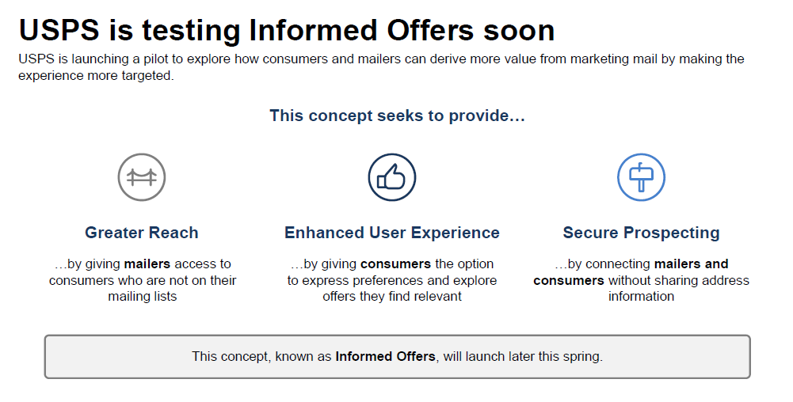

Slide 5
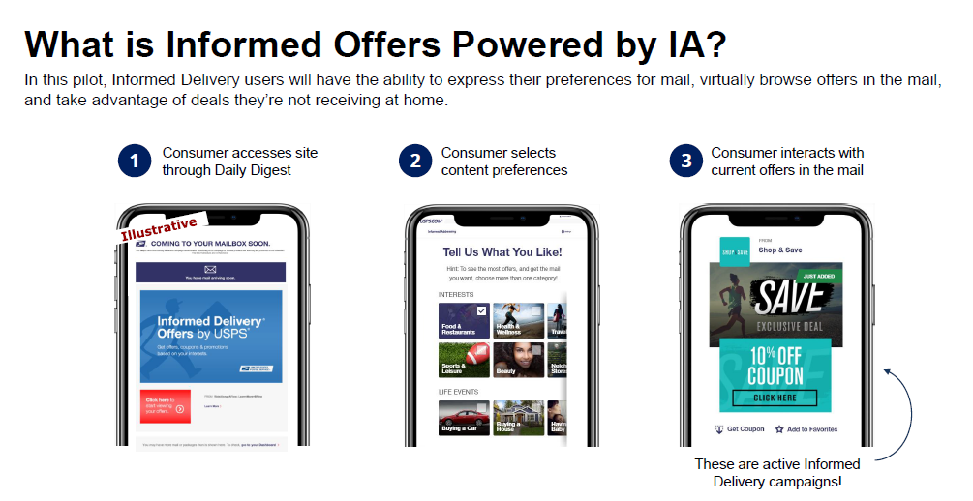

Slide 6
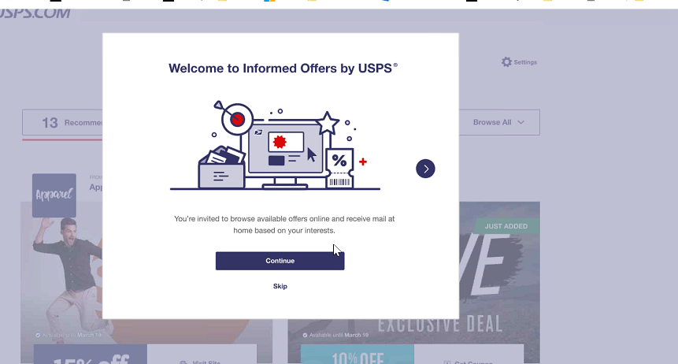

Slide 7
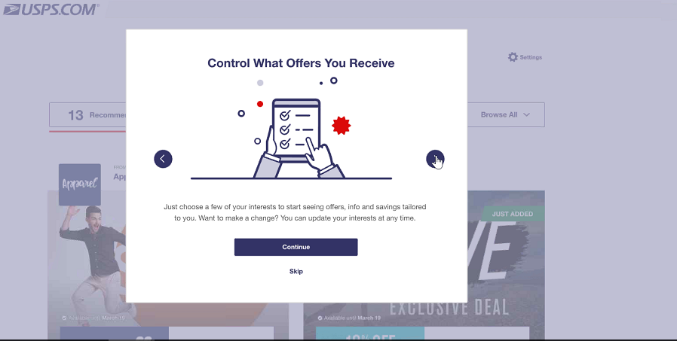

Slide 9
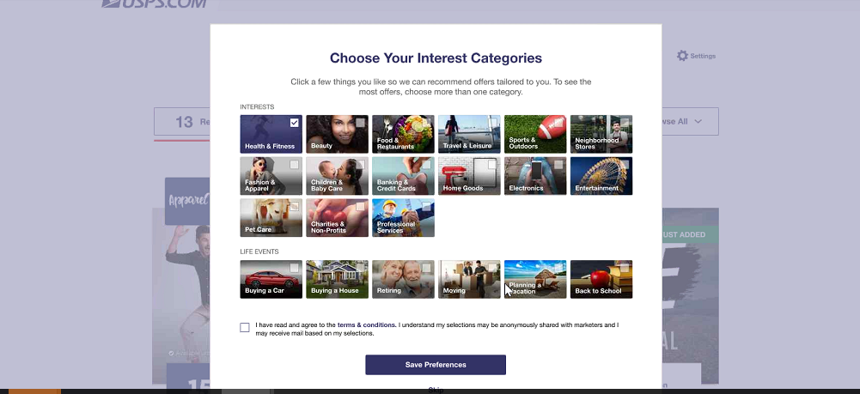

Slide 11
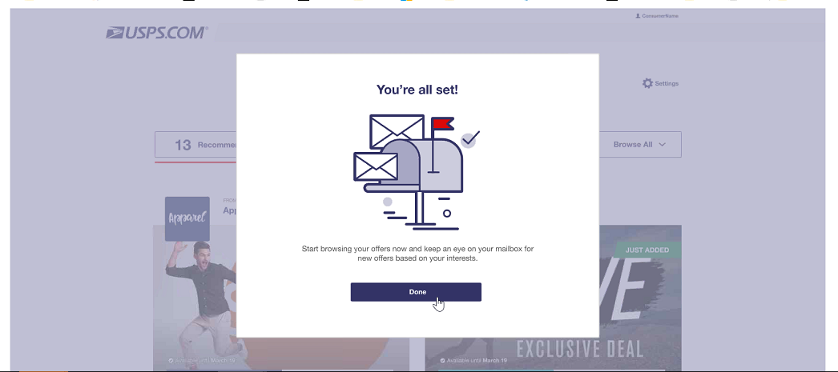

Slide 12
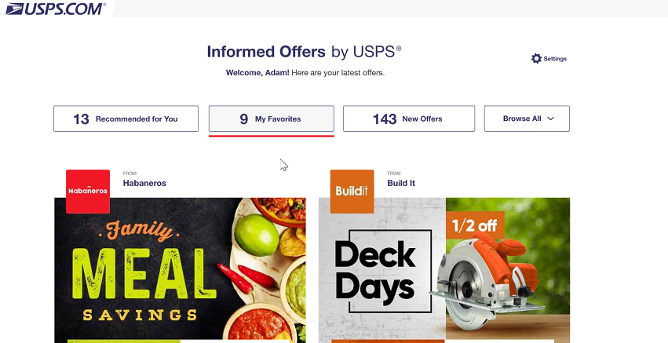

Slide 13
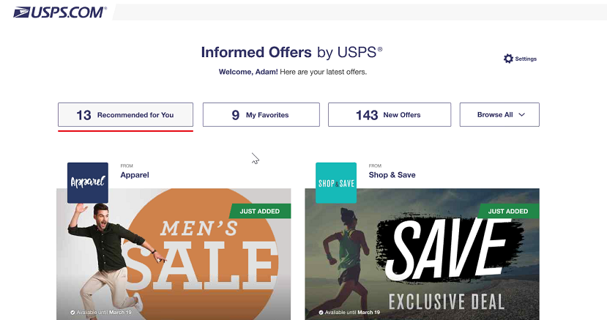

Slide 15
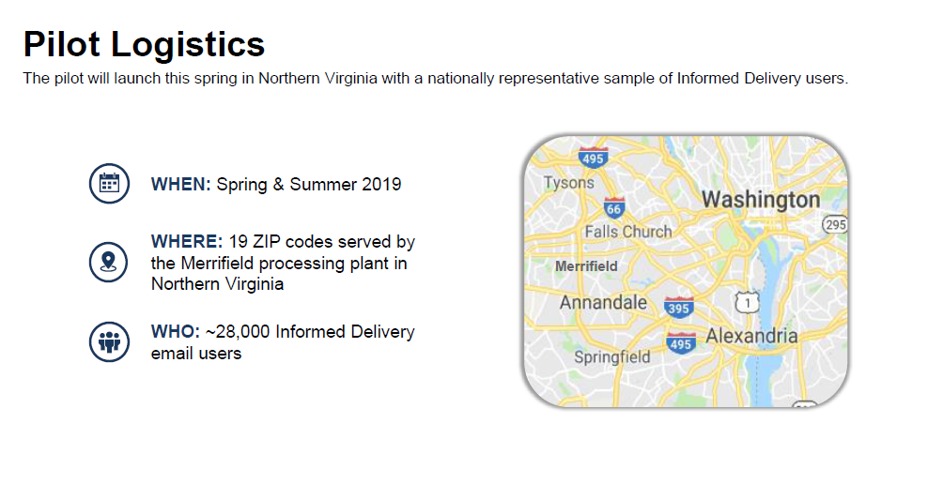
August 2019

Slide 16
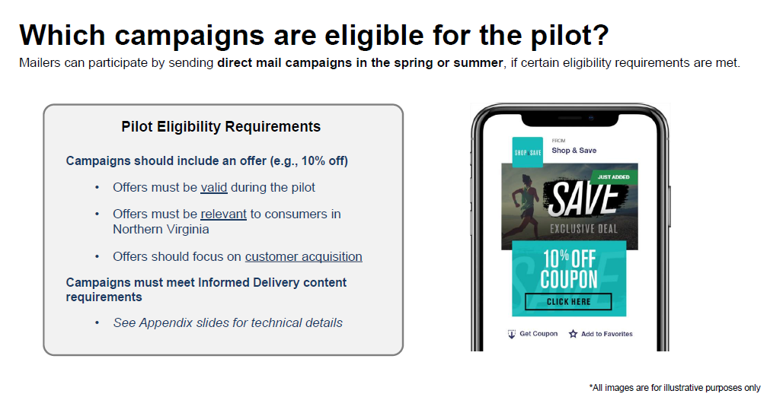
August 2019

Slide 18
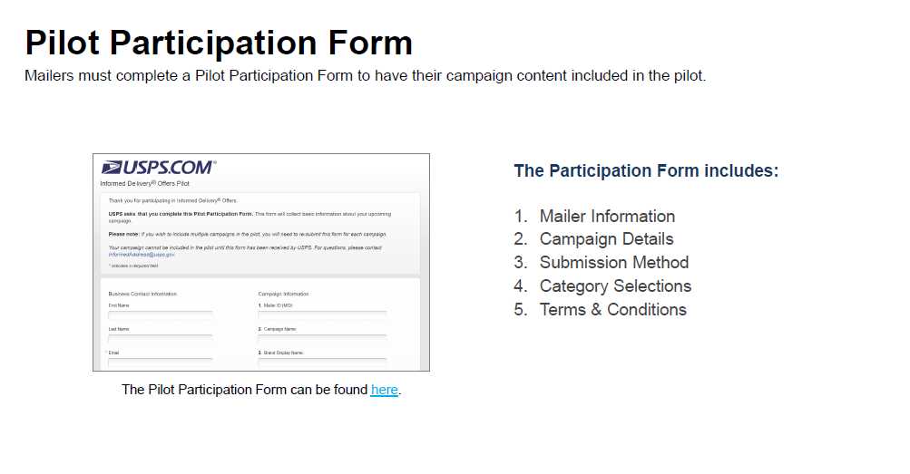

Slide 19
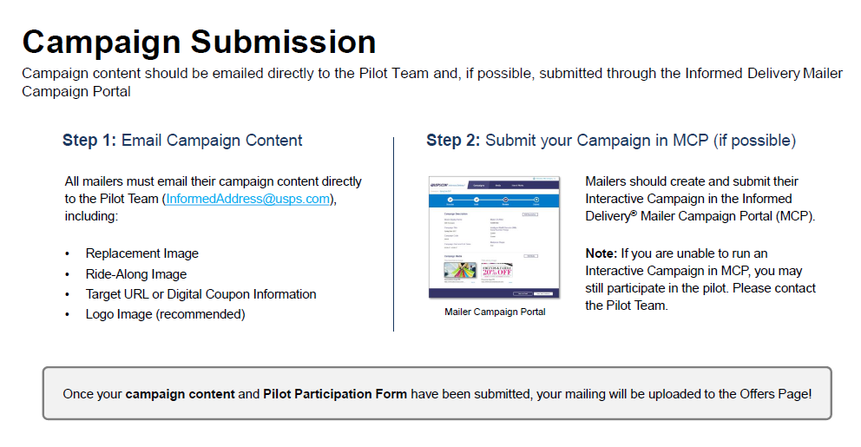

Slide 21
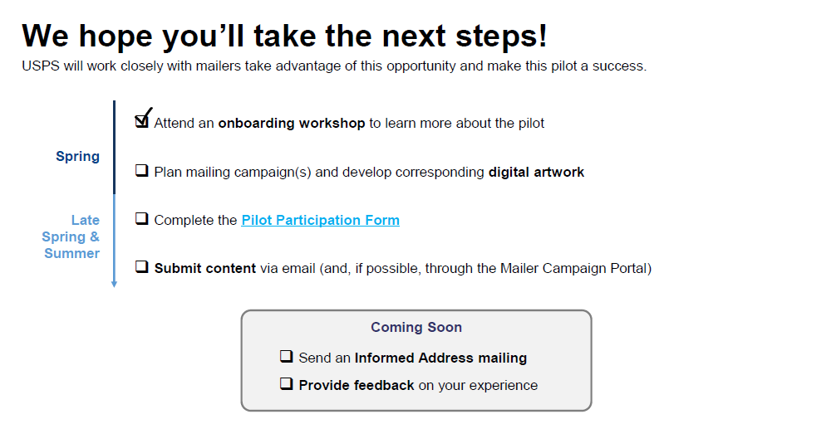

Slide 22
Future Enhancements And Services
Provision Informed Delivery Post-Campaign Data into Informed Visibility.
Enable interactive campaigns on Saturation Mail and EDDM®
Enable interactive campaigns on Packages
Provide enhanced consumer features (examples: allow multiple addresses per user account, provide mail delivery notifications, allow users to indicate a mailpiece doesn’t belong to them)
Enable fee-based campaign positioning (pay for top placement in digest/dashboard)

Slide 23
Informed Delivery interactive campaigns can be submitted by the Mail Owner, a Marketing Agency or a MSP.

Slide 25
Erick Keskey
Nicholas Brandt
Business Alliance Managers
United States Postal Service

